Slide 1
LINEAR DATA STRUCTURES! (AND Binary search trees)
By: Me (Again)

Slide 2
What is a Linear data structure??
A linear data structure is a way of organizing data where elements are stored sequentially
Common operations include insertion, deletion, and searching
Operations are usually performed on elements based on their position in the sequence.
Examples of linear data structures are Stacks, Queues and Linked Lists

Slide 3
What is a Stack
A stack is a linear data structure that follows a particular order in which the operations are performed.
Stack uses Last in First out (LIFO)
A stack has a pointer to the address of the topmost element or the last inserted one of the stack.
Stack uses the operations push and pop to add and remove elements
Insertion and deletion of elements take only takes place from the top.

Slide 4
What is a queue
A queue is a linear data structure that follows a particular order in which the operations are performed.
A queue uses First In First Out (FIFO).
A queue has pointers to the addresses of the front and rear elements of the queue.
A queue uses the operations enqueue and dequeue to add and remove elements.
Insertion of elements takes place at the rear, and deletion of elements takes place from the front.

Slide 5
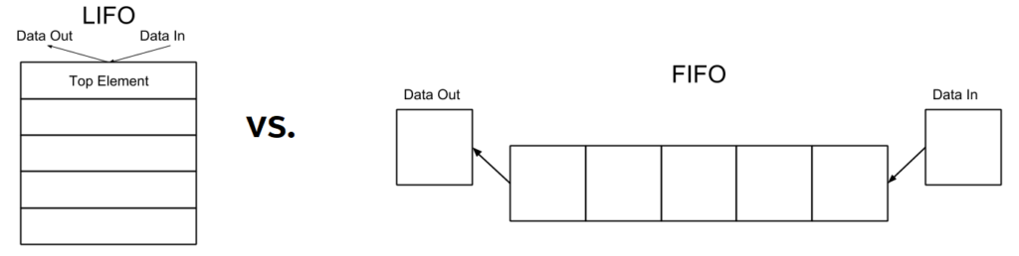
STACK VS QUEUE VISUALIZATION

Slide 6
What is a Linked List?
A linked list is a linear data structure consisting of a sequence of nodes connected via pointers. The sequence of nodes is not stored in contiguous memory.
A linked list can be of different types, such as singly, doubly, or circular. Each node in a linked list contains data and a pointer to the next node in the sequence.
A linked list uses operations such as insertion and deletion to add or remove nodes. Insertion and deletion can occur at any position (beginning, middle, or end) by adjusting the pointers of adjacent nodes.

Slide 7
LINKED LISTS (contd.)
Link lists can be singularly or doubly linked as well as circular.
Singly linked lists can only be traversed in one direction while doubly linked lists can be traversed forwards and backwards.
Both singular and doubly linked lists can also be circular meaning that the last node points back to the first.

Slide 8
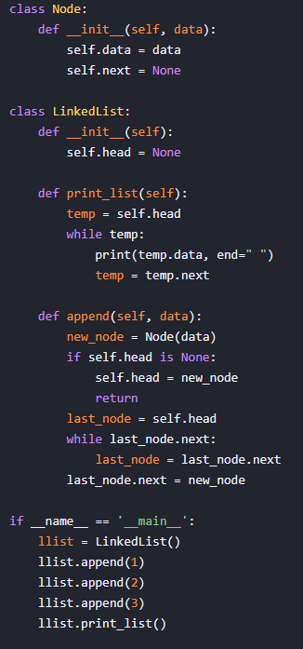
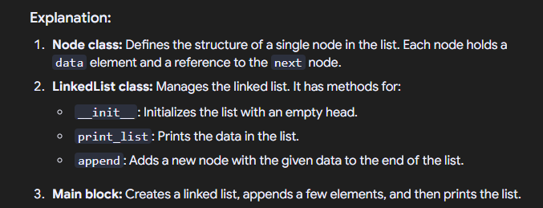
Linked List demonstrations
Singular Linked List

Slide 9
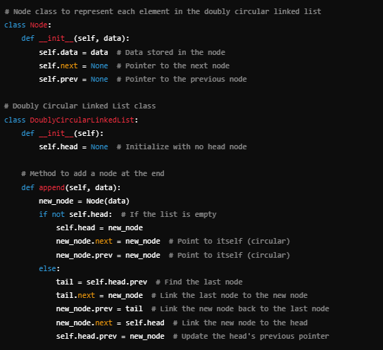
Linked list demonstrations
Doubly Linked List

Slide 10
WHAT IS A BINARY SEARCH TREE?
A binary search tree (BST) is a hierarchical data structure consisting of nodes connected in a tree-like structure. The nodes are not stored in contiguous memory.
A binary search tree follows the binary search property, where:
The left subtree of a node contains values less than the node's value.
The right subtree of a node contains values greater than the node's value.
Each subtree is itself a binary search tree.
Each node in a binary search tree contains data, a pointer to the left child, and a pointer to the right child.
A binary search tree supports operations such as insertion, deletion, and searching to add, remove, or locate nodes.
Insertion requires ensuring the binary search property is maintained by placing new values in their correct position.
Deletion similarly involves removing a node and rearranging the tree while maintaining the binary search property.

Slide 11
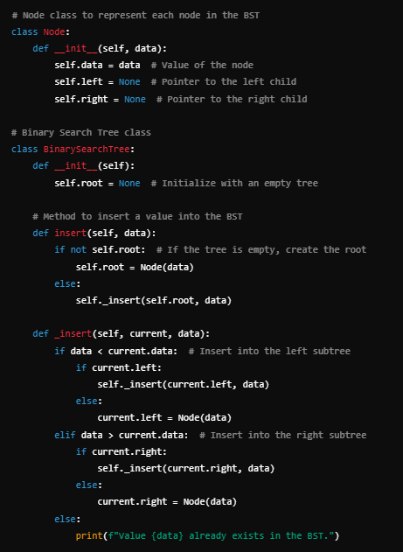
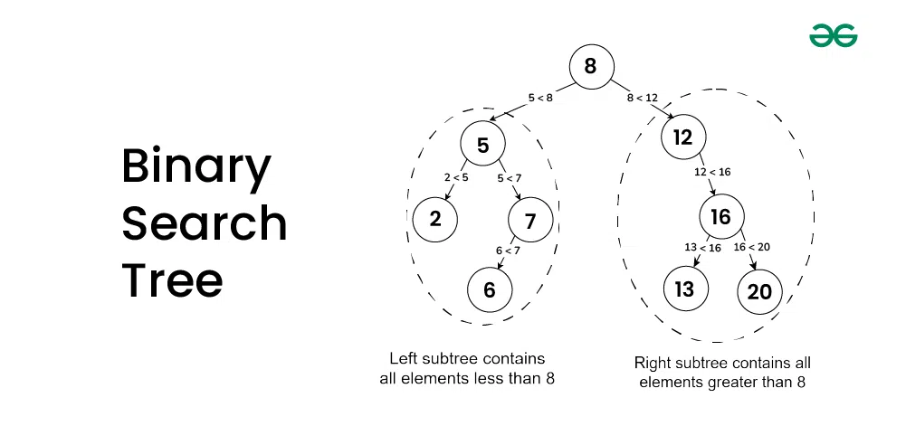
Binary search tree demonstration

Slide 12
QUESTIONS??
No
Plz

Slide 15
SWISS CHEESE YO OPS
(Stack demo??)

